Slide 1

Responding to Affordability Concerns
Tony Searls, Commercial Services Superintendent

Slide 2

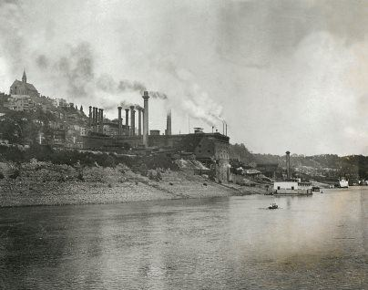
GCWW Background
Municipally owned by the City of Cincinnati
200-year history of proactive utility
World-class treatment facilities
3,100 miles of water main
~240,000 customer accounts
Over 800 mi² service area
1.1 million served regionally
Mission
GCWW employees provide customers with a plentiful supply of high-quality water, support, environmental sustainability, and deliver excellent services in a financially responsible manner.

Slide 3
GCWW Rates & Billing
Water rates are derived from system user charges
Fixed fee
Volumetric charges
GCWW bills, collects revenue, and provides customer support for:
Water
Sewer
Declining rate structure
Monthly bills
Stormwater
Trash & Fire hydrant maintenance

Slide 4
Pre-Covid Shut-off Procedures
Authority provided by Cincinnati Municipal Code
Total past due account balance (including water, sewer, stormwater, trash, and/or fire hydrant charges) above threshold is scheduled for shut-off
Past due revenue collection steps:
  Shut-off completed
  Referred to staff for collection of balance owed
  Referred to outside collection agency or to Law Department for small claims suit

Slide 5
Covid Shutoff Moratorium
Prior to the COVID-19 Pandemic:
  ~10,000 accounts above the shutoff threshold
  Total past due debt ~ $12 million
Shut-offs suspended in March 2020
  Service restored to previously shutoff past due accounts
  Moratorium ended on May 4, 2022
During the moratorium:
  # of accounts > the shutoff threshold grew by 6,000
  Past due debt grew about $15 million by July 2021

Slide 6
GCWW Past Due Balances

Slide 7
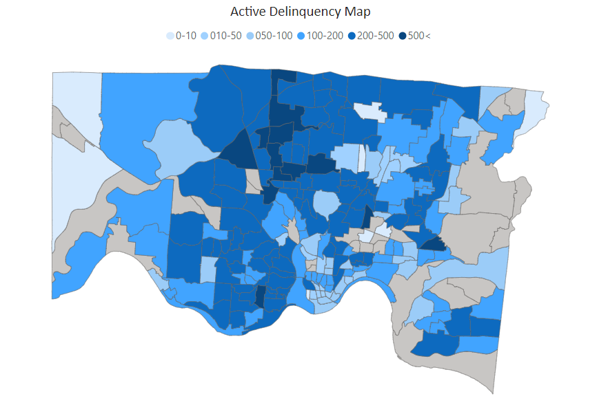

Slide 8
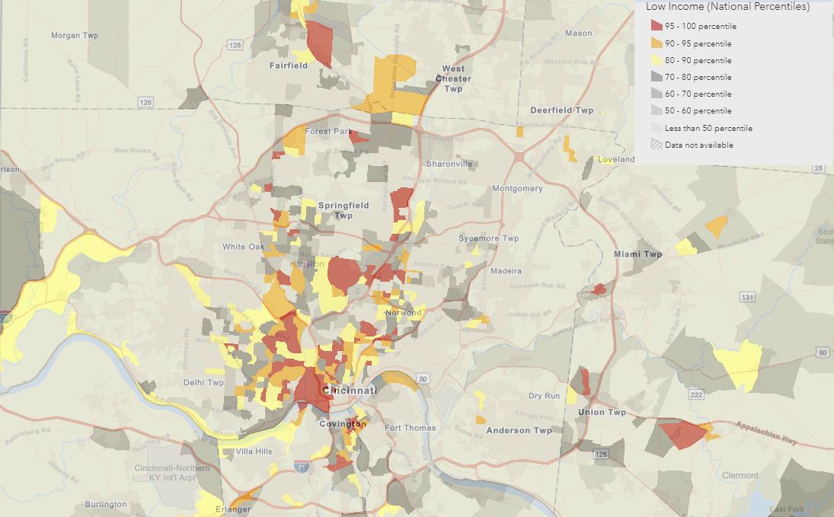
EPA EJScreen, https://ejscreen.epa.gov/mapper/, Pulled 5/1/2023

Slide 9
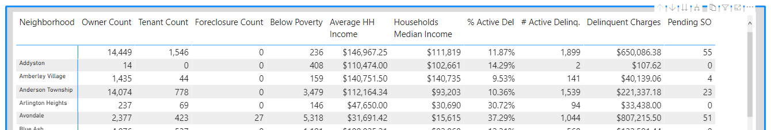
Responding to
Affordability Concerns in Shut-offs
Using neighborhood economic data to schedule shut-offs
Schedule shut-offs two weeks in advance
Call the customer to notify them of the shut-off date and provide assistance options (person to person)
Offering lenient options to re-establish water service after shut-off

Slide 10
Responding to
Affordability Concerns with Assistance
Distributed over $2.7 million in federal relief dollars directly, with ~$1.2 million additional received from local organizations (about 14% of delinquent debt)
Implementing flexible, interest free payment plan portal with 92% success rate: $8 million recovered, $7 million more promised

Slide 11
How It’s Working
Due to the additional outreach prior to a shut-off, 73% of the accounts over the shut-off threshold are paid or enrolled in a pay plan, avoiding shut-off
Delinquent debt has been reduced 28.6% (additional 25% promised)
But…
More than 15% of customers that were shut off are still off
Federal relief funding is drying up
Customers are not compliant on payment plan agreement

Slide 12
Are we meeting our mission?
    Ensuring plentiful supply of water:
      Past due shut-offs without sufficient assistance options
    Providing excellent services:
      Basic customer needs not met
      Disservice through disconnection
    Being fiscally responsible:
      Cost of service must be recovered
      Increasing rates while income levels remain unchanged
    Goal: Explore ways to respond to affordability concerns, while meeting mission through alternative pricing model

Slide 13
Thank you!

