Slide 1

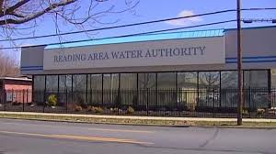
LIHWAP

Slide 2

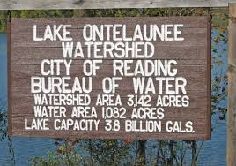
The first public supply of water delivered in Reading was in 1821 by the Reading Water Company. We celebrated our 200th Anniversary in 2021.
Reading Area Water Authority established on May 20, 1994, has the power to, among other things, acquire, hold, construct, improve, maintain and operate water filtration plants and water distribution systems. (Lease)
The water supply for the City of Reading is obtained from Lake Ontelaunee. Lake Ontelaunee is owned by the City and was constructed in 1926. It is located about eight (8) miles north of the City. Lake Ontelaunee has a capacity of 3.88 billion gallons.
We have an Award Winning Source Water Protection Plan.

Slide 3
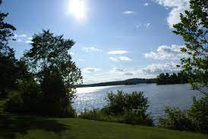
Raw lake water is delivered to the Maidencreek Filter Plant by gravity via a 2,800 foot long, concrete lined, 60 inch diameter conduit with an alternate intake on the Maidencreek which flows right next to the plant. Depending on the season, we draw from either source to take advantage of the raw water quality conditions.
The Maidencreek Filter Plant was constructed in 1935 and has gone through numerous additions, renovations and enhancements. The most recent upgrades will be complete this year with all 8 of the filters being completely renovated.
We maintain Presidential status via the AWWA Partnership program.

Slide 4
The Maidencreek Pumping Station capacity is 25 million gallons per day. Its average daily pumping rate is 15.3 million gallons. The water is pumped to the City’s distribution systems by three (3) force mains; a 36 inch, 30 inch and 24 inch diameter water mains.

Slide 5
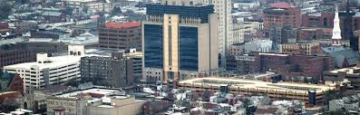
Reading is a city and the county seat of Berks County, Pennsylvania. Reading is the
fourth-largest city in Pennsylvania after Philadelphia, Pittsburgh, and Allentown.

Slide 6
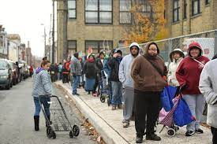
In 2011 Reading was declared the poorest small city in the nation.”

Slide 7

As of the 2020 United States census, Reading had a population of 95,112. Of which,
68.9% were Hispanic/Latino
The median income for a household in the city was $26,698, and the median income for a family was $31,067.

Slide 8
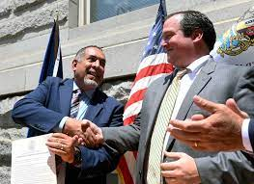
RAWA has had a significant impact on the financial results of the City, increasing its Lease payment strategy from approximately $8mm a year to nearly $13mm. All while holding the water rates stagnant without any increase over the last seven budgets.
The net result is a nearly $30mm savings to the ratepayers and an Annual Budget over $7mm less than it could be had the allowable 3% ACT 47 increases been fulfilled.

Slide 9

In addition, the Authority has built relationships with the City Council and Administrations which has resulted in over $4mm in Lead remediation Grants.

Slide 10
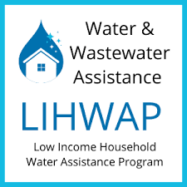
This leads us to a recap of our strategy and results
for the LIHWAP program.
The most important element of our plan was for our Administration to understand the qualifications for the aid and to create a plan to get qualified applicants to apply, using “data” available in our current billing and collection processes.
WE NEEDED TO KNOW THE SYSTEM DAY ONE-
TO GET A JUMP ON OTHERS AND
TO HAVE A PLAN IN PLACE.
WE NEEDED TO WIN THE RACE TO THE POT OF GOLD.

Slide 11

We quickly identified our CSR’s (Customer Service Representatives)
would be the critical component to any success we achieved.

Slide 12

We knew Our Data Base offered an real opportunity for getting qualified candidates to apply. We engaged our IT specialist to do searches in our system.

Slide 13
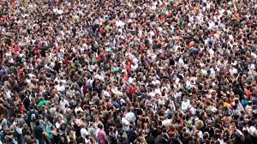
We wanted to help as many people as we could.

Slide 14
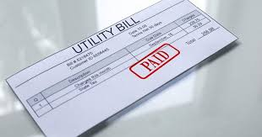
We presumed these would be payments we probably would not have ever seen, if we didn’t get them qualified. It was a huge opportunity for unbudgeted for revenue.

Slide 15

We included basic fundamentals like sending letters informing of the program with a follow up phone call and our CSR’s checking every time a call came in to see if there was an opportunity there.

Slide 16

We knew anyone on a payment plan would qualify
because they could be facing a turn off.
We targeted them. We reached out for them.

Slide 17
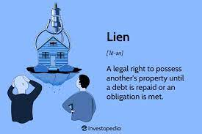
We knew any property with a lien
would most likely qualify so they got
a letter encouraging their application.

Slide 18
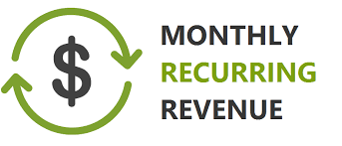
We identified an opportunity with agreements for Follow Up (Paying Account) Opportunity-
For those that qualified!!!
Reoccurring Monthly revenue, potential for even greater revenue than what they qualified for.

Slide 19
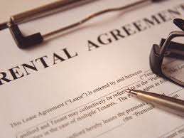
Sent info to both tenant and owner when possible.
Working with landlords when possible.

Slide 20

Lien warning letters now included
The LIHWAP Flyer

Slide 21

Basically we wanted to flood the customers
with information on the program.

Slide 22

When we started to think we reached our limitations we thought outside the box and we used our Collection Agency to inform customers, letters and phone calls

Slide 23

Reward program for CSR accomplishments,
establish goals after we saw response coming in. Validated the “opportunity” and reinvested some of the revenue to expand our outreach.

Slide 24

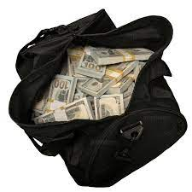
RESULTS
RECEIVED A TOTAL OF $913,972.19
Water- $477,401.34
Sewer- $436,570.85
For 710 Families

Slide 25
$43mm was apportioned for LIHWAP, $38.2mm was given out, balance was used for administration of program, an average of $550.00 was paid to recipients.
As a point of comparison…
Reading has 105,000 customers
Pittsburgh has 465,000 customers
RAWA helped 710 “accounts” receive an average of $678.57 for a total of $913,972.19
Pittsburgh helped 1,300 accounts receive an average of $550.00 for a total of $1.5mm.
***information (approximately) from Pittsburgh NPR News Station and Reading Area Water Authority.***

Slide 26

We completed our audit 1/24/23

