Slide 1
Low-Income Water Customer Assistance Program Assessment Study
Mayor’s Innovation Project
Water Affordability Community of Practice
Eric P. Rothstein, CPA, MA
Galardi Rothstein Group
March 28, 2023

Slide 2
Low-Income Water Customer Assistance Program (LIWCAP)Assessment Study
Prepared for:
  American Water Works Association
  Association of Metropolitan Water Agencies
  National Association of Clean Water Agencies
  National Association of Water Companies
  US Water Alliance
  Water Environment Federation
Prepared by:
  Stacey Isaac Berahzer, IB Environmental
  Janet Clements, One Water Econ
  Zachary Green, Raftelis
  John Mastracchio, Raftelis
  Robert Raucher, Raucher LLC
  Eric Rothstein, Galardi Rothstein Group, LLC
  Manuel P. Teodoro, EJ Metrics, LLC

Slide 3
LIWCAP Assessment Report Outline
Executive Summary
Introduction
Program Evaluation Framework
Needs Assessment
Federal Low-Income Program Precedents
Program Administrative Pathways
Funding Distribution to Regions and States
Outreach and Customer Application
Utility Service Provider and Utility Sector Roles
Program Evaluation & Reporting
Conclusions and Recommendations

Slide 4
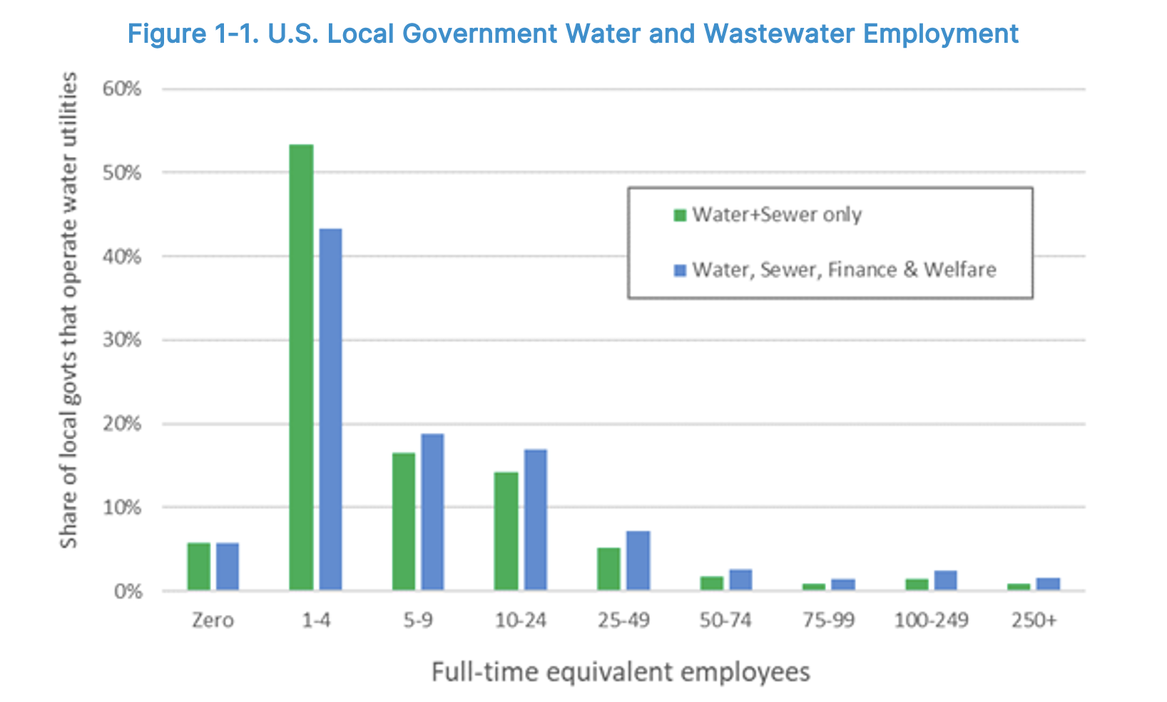
Introduction

Slide 5
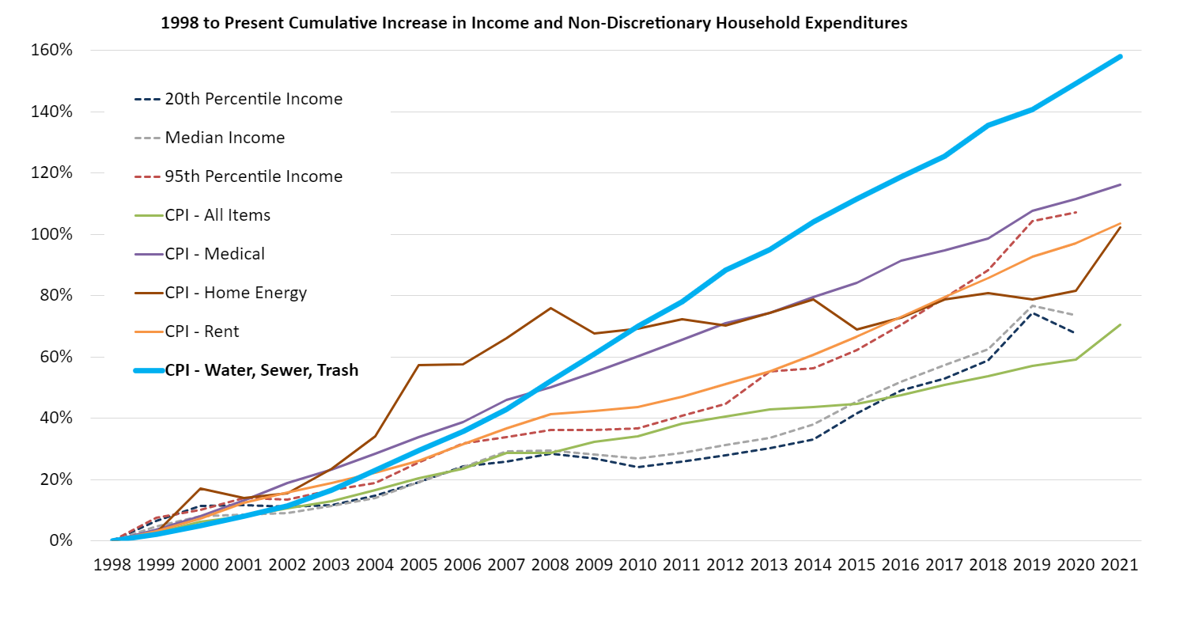
Needs Assessment

Slide 6
Needs Assessment
Methodological construct:
– Need based on water cost as percentage of income
 | Cost of Water & Wastewater Service as % of Income
Income Range | Threshold #1 | Threshold #2 | Threshold #3 | Threshold #4
<$10,000 | 8% | 4.5% | 3% | 2.0%
$10,000 - $14,999 | 7% | 4.5% | 3% | 2.5%
$15,000 - $24,999 | 6% | 4.5% | 3% | 3.0%
$25,000 - $34,999 | 5% | 4.5% | 3% | 3.5%
$35,000 - $49,999 | 4% | 4.5% | 3% | 4.0%
$50,000 - $74,999 | 3% | 4.5% | 3% | 4.5%
 | National Water & Wastewater Service Affordability Need Estimates
Scenario | #1 | #2 | #3 | #4
Needs Estimate ($billions) | $2.4 | $4.5 | $7.4 | $7.9

Slide 7
LIWCAP Program Administrative Pathways
LIHWAP 2.0 would refine, expand, and make permanent the existing LIHWAP program, perhaps combining its administration with LIHEAP’s and extending its funding indefinitely
SNAP H20 would expand SNAP—the existing federal food program administered by USDA—to allow SNAP participants to use their benefits to pay for water and wastewater bills.
LIWCAP via Utilities would be funded through the USEPA and administrated directly by water and wastewater utilities.
LIWCAP via Community Organizations would be funded through the USEPA and administrated by community organizations.
LIWCAP Hybrid would be funded by the USEPA and administered by either utilities or community organizations, with state agencies determining specific administrative arrangements according to local conditions.

Slide 8
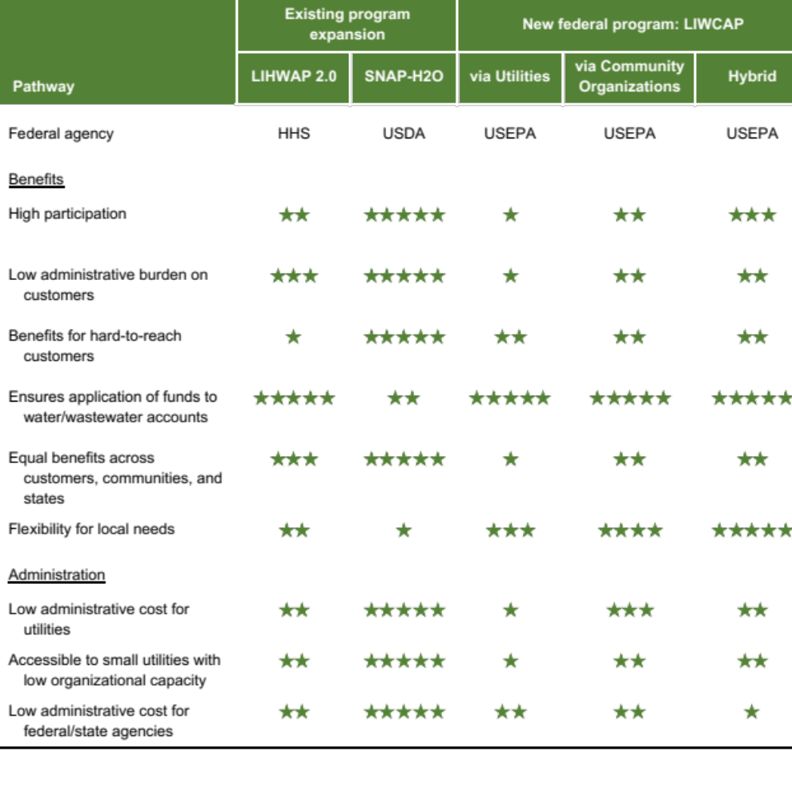
Major Attributes of Alternative Pathways
Highlights key tradeoffs

Slide 9
Utility Service Provider and Utility Sector Roles
Collaboration with local community organizations
  Program outreach
  Administrative
Affordability reporting
Complementary programs/approaches (within organizational capacity constraints)

Slide 10
Key Conclusions and Recommendations
Pathway Dependent
  LIHWAP 2.0
  SNAP H20
  LIWCAP – Utilities
Pathway Independent
  Use of advanced technology
    Payment systems (e.g., EBT transfers, administrative processes)
  Program marketing/outreach (leveraging mobile apps)
  Foster collaboration of local social service organizations and utilities
  Improved and sustained water affordability (and LIWCAP performance) data collection, reporting and analysis

Slide 11
Disclosure
Galardi Rothstein Group (GRG) is a registered Municipal Advisor within the meaning as defined in Section 15B (e) of the Securities Exchange Act of 1934 and the rules and regulations promulgated thereunder (Municipal Advisor Rule).
However, GRG is not acting as a Municipal Advisor during this webinar, and the opinions or views contained herein are not intended to be, and do not constitute “advice” within the meaning of the Municipal Advisor Rule.
This material is for general information purposes only and is not intended to provide specific advice or a specific recommendation.

